Slide 1

GLOBAL OPEN DATA INDEX
Emma Beer
emma.beer@okfn.org
@emmakbeer
Open Knowledge
okfn.org

Slide 2

We are a global network using advocacy, technology & training to unlock information and data and empower citizens and organizations to drive positive change.

Slide 3
What we assess
Openness of datasets assessed by a global community of over 70 volunteers worldwide. Citizen assessment of open datasets (according to the Open Definition)
  Assessing the openness of government datasets validation by country-level experts
  Sample validation by dataset experts
Open Definition (v. 2): “Open means anyone can freely access, use, modify, and share for any purpose (subject, at most, to requirements that preserve provenance and openness).”

Slide 4
The datasets assessed
A crowd-sourced assessment of open data. The datasets were chosen based on the G8 Open Data Charter principles and after consulting with the Open Government Community.
transport timetables
government budget
government spending
election results
company register
national map
national statistics
legislation
postcodes/zipcodes
pollutant emissions
Notes:
The Global Open Data Index benchmarks open data by looking at ten key datasets in each place. These datasets were chosen based on the G8 key datasets definition and after consulting the Open Government Community. This year the Global Open Index examines the following ten datasets:
1. Election Results (national) - Results by constituency/district for all major national electoral contests
2. Company Register - List of registered (limited liability) companies including name, unique identifier and additional information such as address, registered activities. The submissions in this data category does not need to include detailed financial data such as balance sheet etc.
3. National Map (Low resolution: 1:250,000 or better) - High level map at a scale of 1:250,000 or better (1cm = 2.5km)
4. Government Spending (high level of spending by sector) - Records of actual (past) national government spending at a detailed transactional level; at the level of month to month government expenditure on specific items (usually this means individual records of spending amounts under $1m or even under $100k). (Note: Just a database of contracts awarded or similar is not considered sufficient. This data category refers to detailed ongoing data on actual expenditure)
5. Government Budget (detailed transactional level data) - National government budget at a high level (e.g. spending by sector, department etc). This category is about budgets which are government plans for expenditure (not actual expenditure in the past).
6. Legislation (laws and statutes) - This data category requires all national laws and statutes available to be available online, although it is not a requirement that information on legislative behaviour e.g. voting records is available.
7. National Statistical Office Data (economic and demographic information) - Key national statistics such as demographic and economic indicators (GDP, unemployment, population, etc). Aggregate data (e.g. GDP for whole country at a quarterly level, or population at an annual level) is also considered acceptable in this data category. In general, answers of 'yes' in this category refers to entries with a reasonable amount of both economic and demographic information available.
8. National Postcode/ZIP database - A database of postcodes/zipcodes and the corresponding geospatial locations in terms of a latitude and a longitude (or similar coordinates in an openly published national coordinate system). A database which gives a location in terms of the name of a town or a street without lat/long coordinates is not considered acceptable unless the name of the town or street can be further converted to a latitude and longitude by means of other open data (eg an open gazetteer with latitude and longitude attributes).
9. Public Transport Timetables - Timetables of major government operated (or commissioned) national-level public transport services (specifically bus and train). The focus here is on national level services (not those which operate only at a municipal or city level and which are not controlled or regulated by the national government). A 'yes' in any question will refer to both types of transport. However, if there is no national level service operated or regulated by the government for a given type of transport (for instance busses), then this type is ignored in this data category. Environmental Data on major sources of pollutants (e.g. location, emissions) - Aggregate data about the emission of air pollutants especially those potentially harmful to human health (although it is not a requirement to include information on greenhouse gas emissions). Aggregate means national-level or more detailed and on an annual basis or better. Standard examples of relevant pollutants would be: carbon monoxides, nitrogen oxides, particulate matter etc.

Slide 5
How we assess it
The following questions examine technical openness:
Does the data exist?
Is the data in digital form?
Is the data available online?
Is the data machine-readable?
Is it available in bulk?
Is the data provided in a timely and up to date basis?
The following questions examine the legal status of openness:
Is the data publicly available?
Is the data available for free?
Is the data openly licensed?

Slide 6
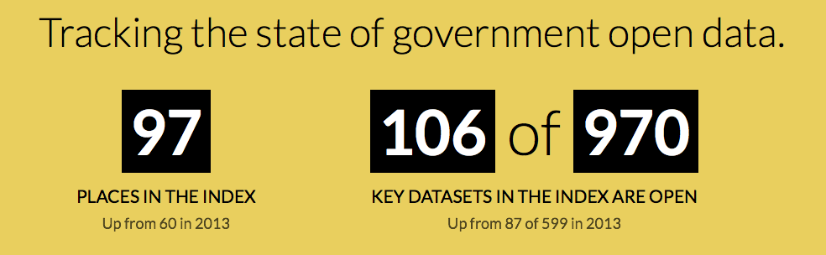
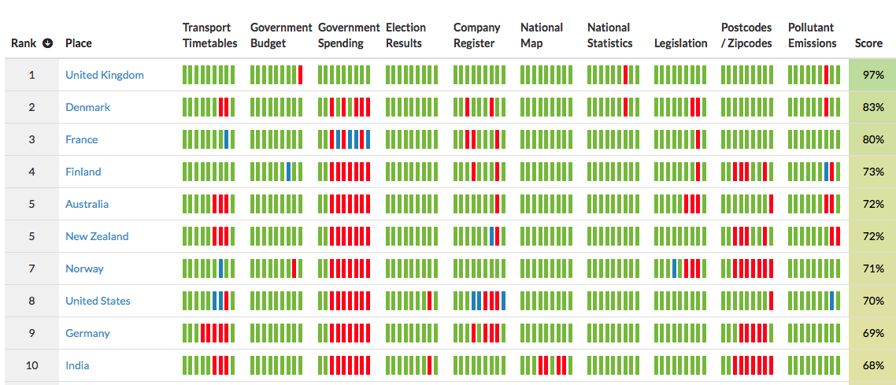
Results

Slide 7
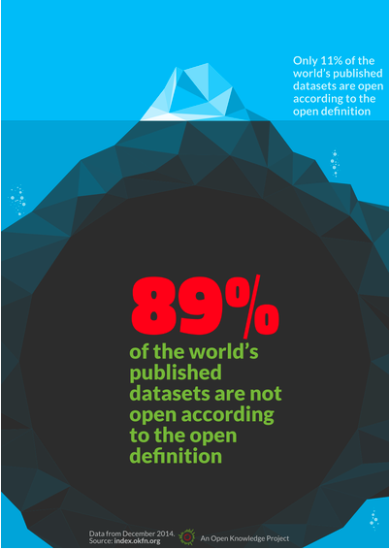
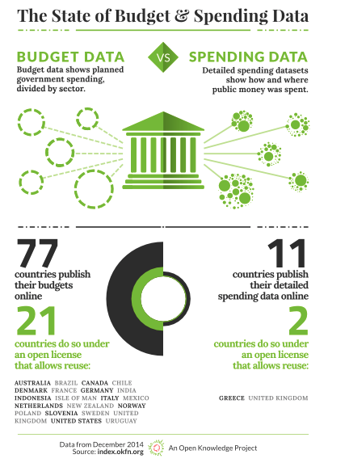

Slide 8
Results
The United Kingdom, a leader in open government, topped the Index again
France: Most improved award goes to the government of France now at #3 up from #12 last year. The French government has put significant effort on opening data to the public while having a dialogue with civil society. They also launched a new data portal and have a strong emphasis on releasing data in bulk and in a machine readable format, which has given them points. There are still some key issues, but France can top the leader board next year if it keeps up the work they are doing.
Greece: a country which has been in the headlines with regards to its government spending, has scored high on openness of government spending. Thanks to a new spending portal https://diavgeia.gov.gr/ Greece is one of only two countries who scored full marks on the openness of government spending in the Global Open Data Index 2014.
Notes:
Scrap this analytics

Slide 9
Results
● The Russian Federation falls well behind its recent G7/8 peers coming in at #45
● India dramatically improved to #10 - launching a new data portal coincided with a major push to release more and better data
● Colombia: First time included in the index and ranked 12th along with Uruguay, ranking the same as progressive Sweden (also #12) and leaving behind Austria on #22
● Africa: South Africa is leading the continent in 36th place on the global scale, but the next one after it Burkina Faso in #59. Guinea is closing the list as #97. Main issues are not the openness of data but the lack of data.
Notes:
Scrap this analytics

Slide 10

Community
index.okfn.org/stories/

Slide 11
United Kingdom
Frances Maude, Minister for the Cabinet Office (United Kingdom):
"We’re delighted to see the UK retain its number one position in the Open Data Index. We believe this recognizes the UK continues to have a leading position in this globally important area and recognizes our efforts ongoing efforts to be the most transparent and open government in the world.”

Slide 12

France
Axelle Lemaire, Secretary of State for Digital Affairs:
"I am thrilled that France has registered the biggest boost in the new index, zooming up from 12th to 3rd." "One big step forward came from over a year of debate with the Postal service, civil society organisations like Open Street Map, the official institute de géographique national and our open data team – it lead to the release of a comprehensive address list. Our belief is that open data is good but engaging in uses of open data is even better, and the new platform set up at data.gouv.fr does just that: anyone can contribute, reuse and build upon public data: truly people powered public services!"

Slide 13
Impact anecdotes
Denmark: “Important to push for more open data. Important to push for the use of open data, "we have a lot of open data, why don't we make use of it?”
Nigeria: “let government institutions know how to openly license their data, and empower citizens”
Rwanda “It is imperative to be able to learn quickly from other countries”
Kenya “Open data allows citizens make inf. choices about their lives”

Slide 14
Twitter campaign
The US ranked 8th on the Global ‪#OpenData Index. ‪http://ow.ly/Gf4wt ‪#openindex14 thanks ‪@OKFN for the useful tool!
‪#openindex14‪ has been a great #community effort to benchmark #government #opendata around the world http://ow.ly/Gf0GP #transparency
'Data Journalists are also one of the beneficiaries of the Global ‪#OpenData Index.' ‪http://ow.ly/Gf4wt ‪#openindex14 ‪#NEPAL
‪#Burkina‪ Faso’s #openindex14 story. "Often the publication of data does not include ‘reuse’." http://bit.ly/1zrW3X5 #open #government
#Kenya’s #openindex14 story. “Open data allows citizens make inf. choices about their lives” http://bit.ly/1wJAU8C "

Slide 15
Success
“We have noted that for the Company Register dataset on the Global Open Data Index, Australia is ranked #11, with an indication that the license under which the data is published is not open.
I am writing to inform you that we have now changed the license to Creative Commons 3.0 http://creativecommons.org/licenses/by/3.0/au/; this dataset is now published under an open license.”

Slide 16
Fierce competition, creative country-level tweets
Emma Beer
emma.beer@okfn.org
Join the community at open-data-census@lists.okfn.org

Slide 17
If you release your data openly, make sure the people who can benefit from its release are made aware of it

Slide 18
Martin Alvarez-Espinar
PSI Re-use Scoreboard

Slide 19
Questions
What x is the thing that should be done to publisher or reuse PSI?
Measuring and benchmarking open data initiatives using common (and transparent) indicators and methodologies. Encourage publishers to be aware of the indicators developed in the community to improve quality and transparency for their own publishing practices.
Why does x facilitate the publication of reuse of PSI?
Encourages the adoption of best practices, helps improve the effectiveness of the initiatives, offers a degree of comparability - ideally at the national, regional and thematic level.
How can one achieve x and how can you measure or test it?
Implementing a methodology along with a set of indicators enabling comparison of successful and unsuccessful initiatives. Also the ability to judge the progress made against open data initiatives year by year.

