Slide 1

Data on the Web Best Practices Working Group
DWBP CR Transition Call - August 2016
Staff Contact
Phil Archer
WG Chairs
Hadley Beeman
Deirdre Lee
Yasodara Córdova
DWBP Editors
Bernadette Lóscio
Caroline Burle
Newton Calegari

Slide 2
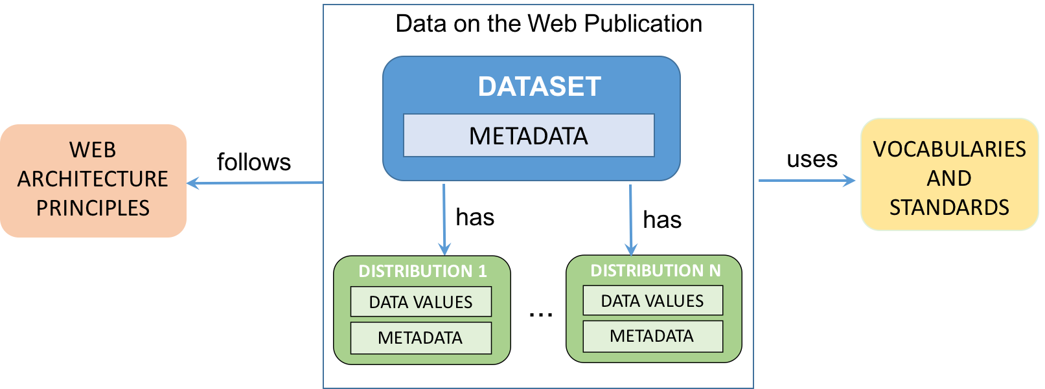
Introduction and Context
According to the DWBP Charter, the Data on the Web Best Practices Working Group was agnostic about the technologies it considers important. Specifically, it promoted best practices based on Use Cases & Requirements to make use of the full potential of the Open Web Platform's ability to link one fact to another, to discover related resources and to create interactive visualizations.

Slide 3
Phase 1: DWBP scope definition
F2F London
data on the Web challenges, data on the Web lifecycle, outline of the use cases and vocabularies scope
2nd
draft DWBP Use Cases & Requirements
FPWD DWBP (27 best practices)
external comments
June
2014
October
2014
February
2015
3
06
10
10
02
6
10
10
2
2
02
March
2014
October
2014
February
2015
F2F Santa Clara
scope questions , 1st draft of the table of contents of DWBP document, initial set of DWBP
WG Note DWBP Use Cases & Requirements
26 use cases, 14 challenges and 42 requirements
FPWD DWBP Use Cases & Requirements

Slide 4
Phase 2: DWBP refinement
F2F Austin
open issues and external feedback
(metadata, data enrichment,…)
F2F São Paulo (DWBP agenda)
issues about data vocabularies, data versioning, sensitive data, data identification, data on the Web benefits
4th
draft DWBP
(minor changes)
June
2015
December
2015
February
2016
4
06
10
10
02
6
9
10
1
2
02
April
2015
September
2015
January
2016
Detailed review
comments to be considered before the publication of the last working draft
2nd draft DWBP (33 best practices)
FPWD DUV
FPWD DQV
external comments
3rd draft DWBP
external comments

Slide 5
Phase 3: DWBP final review
F2F Zagreb (DWBP agenda)
last open issues before the publication of the last working draft, Share-PSI meeting
DWBP last call for review
broad dissemination of DWBP, DUV and DQV (Eng and Pt-br)
(email, twitter, facebook…)
external comments
DWBP final updates
all comments were discussed and the resolutions were reported to the commenters (minor changes)
May
2016
July
2016
August
2016
3
06
10
10
02
5
5
7
8
8
02
March
2016
May
2016
August
2016
Last draft DWBP
(35 best practices)
DWBP CR Transition Call
DWBP implementation

Slide 6
DWBP Editors
Use Cases & Requirements
Bernadette Lóscio
Phil Archer
Deirdre Lee
Data on the Web Best Practices
Bernadette Lóscio
Caroline Burle
Newton Calegari
Data Usage Vocabulary
Bernadette Lóscio
Eric G. Stephan
Bernadette Lóscio
Data Quality Vocabulary
Antoine Isaac
Riccardo Albertoni

Slide 7
Acknowledgements
The editors gratefully acknowledge the contributions made to this document by all members of the working group. Especially Annette Greiner's great effort and the contributions received from Antoine Isaac, Eric Stephan and Phil Archer.
This document has benefited from inputs from many members of the Spatial Data on the Web Working Group. Specific thanks are due to Andrea Perego, Dan Brickley, Linda van den Brink and Jeremy Tandy.
The editors would also like to thank comments received from Adriano Machado, Adriano Veloso, Andreas Kuckartz, Augusto Herrmann, Bart van Leeuwen, Erik Wilde, Giancarlo Guizzardi, Gisele Pappa, Gregg Kellogg, Herbert Van de Sompel, Ivan Herman, Leigh Dodds, Lewis John McGibbney, Makx Dekkers, Manuel Tomas Carrasco-Benitez, Maurino Andrea, Michel Dumontier, Nandana Mihindukulasooriya, Nathalia Sautchuk Patrício, Peter Winstanley, Renato Iannella, Steven Adler, Vagner Diniz and Wagner Meira.
The editors also gratefully acknowledge the chairs of this Working Group: Deirdre Lee, Hadley Beeman, Yaso Córdova and the staff contact Phil Archer.

