Slide 1

Bridging the Gap between eBook Readers and Browsers
UNIVERSITY OF CALIFORNIA, BERKELEY
SCHOOL OF INFORMATION
eBooks: Great Expectations for Web Standards
W3C Workshop on Electronic Books and the Open Web Platform
Robert J. Glushko (glushko@berkeley.edu)
Erik Wilde (dret@berkeley.edu)
Luis Aguilar (luis@ischool.berkeley.edu)
Fred Chasen (fchasen@ischool.berkeley.edu)
February 11, 2013

Slide 2
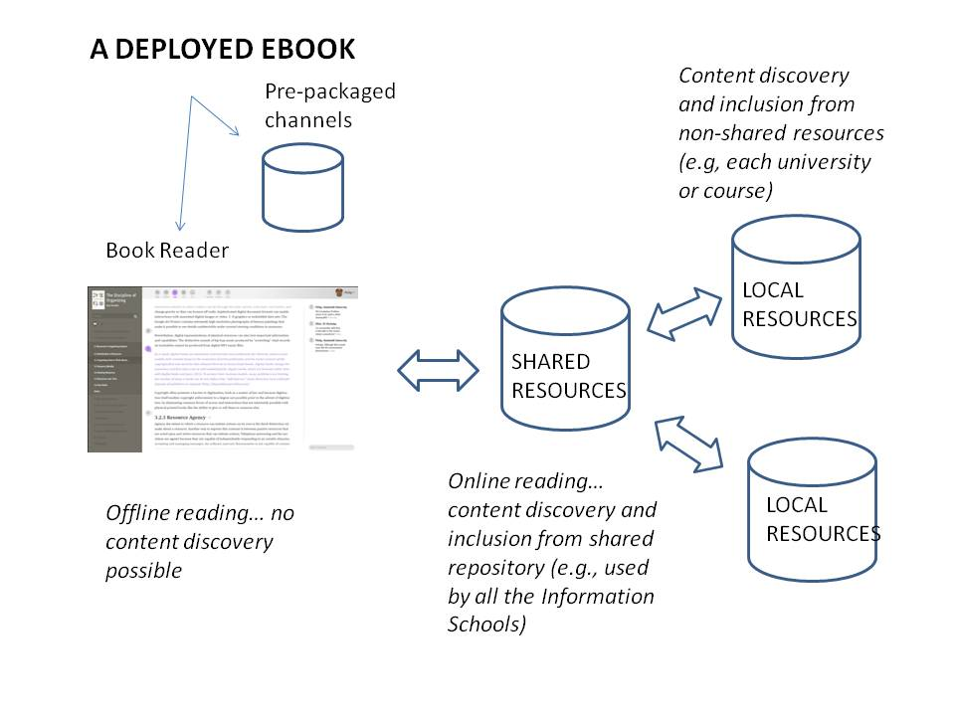
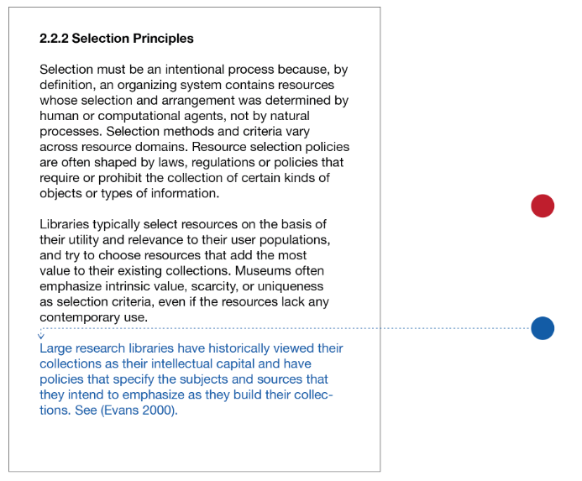
One (of many) Motivation(s): Collaborative
Teaching with a Multidisciplinary Textbook

Slide 3
Books and the Web
“On” the Web vs. “of” the Web
  “on the Web” means Web as a delivery channel
  “of the Web” means Web as the service fabric
Think “Flash sites” or “Google docs” vs. “Web sites”
  The first two require proprietary client-side support
  Web sites require only standards client-side
Current ebook readers are closed devices
  Consuming machines within a walled content garden
  Maybe some reuse of web technology, but primarily for engineering reasons (e.g. webkit for rendering)

Slide 4
A Browser is a Reader
A Reader is a Browser
Making eBooks Web content is essential
  Prevents lock-in, promotes client diversity, open access
  Content standards (HTML/CSS) are more than good enough
Making eBooks Web resources is essential as well
  eBooks should be first-class (linkable) Web citizens
  Resource standards (URI/HTTP) should be followed
Open access and service innovation are critical
  Current packaging and distribution makes user-defined book libraries impossible, allowing only publisher and platform-based ones
  Closed architectures should be left to industry for market segments that need and demand them

Slide 5
Example: Storing Content
Our scenario requires a uniform browser-agnostic solution for offline local access to resources
  Resources on the Web are identified by URIs
  Offline mode should provide offline access to URIs
Many “Web technologies” are not very webby
  Resource access requires much more than a URI
  localStorage is a primitive client-side key/value store
  File API provides access to the client’s file system
If it doesn’t have a HTTP URI, it’s not on the Web
  Must respond to the Web’s uniform interface
  Interactions can be negotiated by the Web’s fabric, not by APIs that create a parallel universe

Slide 6
AppCache Problems
Designed for Web apps and not Web content
  Packaging of HTML/JS/CSS/img for delivery
  One “app” from one “store” to “run” in the browser
What’s wrong with this picture?
  Browser UIs for managing appcache are bad
  Browser APIs for managing appcache do not exist
Apps have fixed boundaries, ebook content is fuzzy
  Apps often have a well-defined set of resources
  ebooks are hypertext and can transclude the Web, so we need to be able to dynamically add content to appcache

Slide 7
ConCache (or, “Intelligent Persistence”)
Fix appcache to make sense for Web content
  Add API for exploring and changing the client cache with URIs, not by filesystem or db methods
  Defines a clear book “boundary” so you don’t cache the entire web
  Both server and client changes should be possible
Browsers should have decent UIs for handling content saved locally
  Allow users to move content between browsers/computers
  Allow users control over when it’s refreshed
  Export/import could be something like ePub

Slide 8
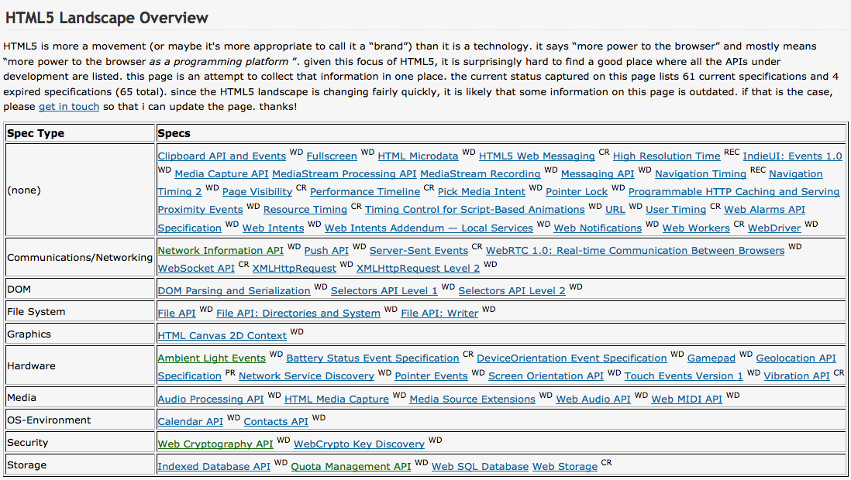
OS-ifying the Browser
http://dret.typepad.com/dretblog/html5-api-overview.html

Slide 9
Thanks!
Robert J. Glushko (glushko@berkeley.edu)
Erik Wilde (dret@berkeley.edu)
Luis Aguilar (luis@ischool.berkeley.edu )
Fred Chasen (fchasen@ischool.berkeley.edu )

