Slide 1
Semantic Annotation and Search for Resources in the Next Generation Web
Ajith H. Ranabahu, Amit Sheth, Maryam Panahiazar, Sanjaya Wijeratne
Kno.e.sis Center
Wright State University
Dayton OH
W3C Workshop on Data and Services Integration
October 20-21 2011, Bedford, MA, USA

Slide 2
Agenda
The service Integration problem
  What are the patterns we see?
What is the best course of action?
  Making the best use of HTML 5 and search engines (Google / Bing)
Experience from Kino
  Annotate-Index-enhance-search Lifecycle for biology oriented documents
Kino Web
  Annotations with schema.org and SA-REST service model
  SA-REST, Microdata or any other mechanism

Slide 3
Before we start - Our Assertions
There is no global model or representation
  Accept it!
  Instead we can represent one in a universally acceptable way
Human in the loop is important!
  Don't forget the guy in the trench
Grass roots / bottom up
  Top down approaches are expensive to adopt

Slide 4
What is the Problem ?
Services are (still) described in multiple ways
SOAP vs REST debate is not as bad but still exists
SOAP services have found its home in the enterprise

Slide 5
What is the Problem ? (Cont)
REST has become the (de facto) standard in the consumer space
No agreed upon formal description (WSDL 2.0 / WADL ?)
No specific registry mechanism - Developers just Google to find the services.
Several high profile composition tools failed ! (Google Mashup Editor, Microsoft popfly)

Slide 6
What have we learnt ?
Services (and Web APIs / services wrapped by programming language) are primarily composed by humans
  Read the documentation, copy sample code and use Google generously
Special purpose indexes and registries do not work.
  General purpose search engines (Google / Bing / Yahoo) has become really good

Slide 7
Anticipated Future Trends
Service consumption and composition is going to remain a semi-automated process
    Humans will always be part of the process
General purpose Search engines are going to be the key source of data for service composers

Slide 8
Our Primary Premise
Modification of service descriptions via
annotations is the best way to supplement the upcoming service consumption patterns
We are not alone in this thinking!
  The trend towards microdata and 'rich snippets'

Slide 9
A Generic Architecture for the Annotation / Index / Search Cycle
Annotation
Search
Web
Documents
Annotation Submission
or acquisition Process
Document Extraction
Third party Data Sources
Index
Annotation Enhancement

Slide 10
Experience from Kino (Kino^{E})
A tool for biologists
Modify Web pages using SA-REST annotations
  Concepts come from National Center for Biomedical Ontologies (NCBO)
Use a specialized indexing engine that can parse the annotations and provide faceted searching

Slide 11
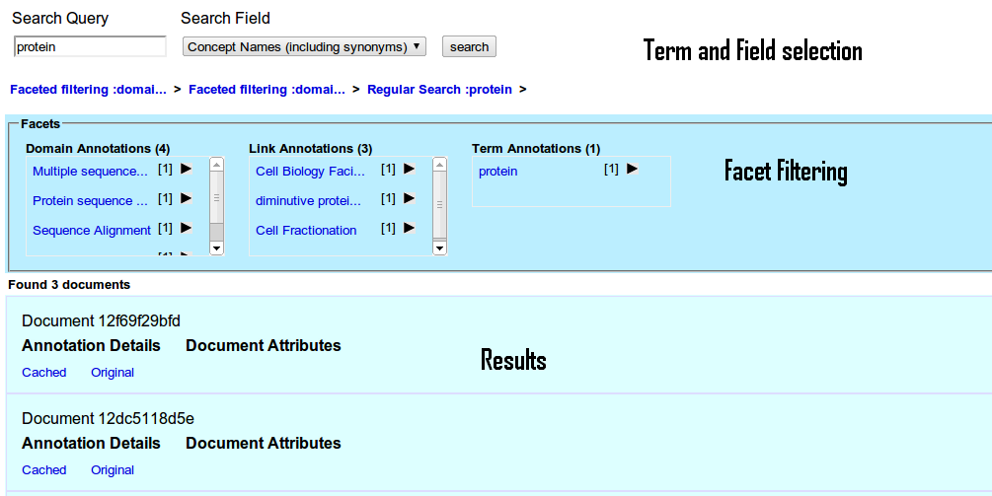
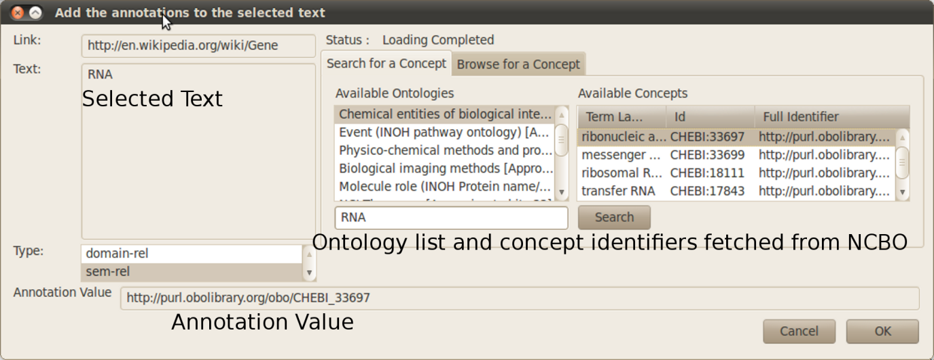
Kino^{E} Architecture
Kino browser based annotation
Kino Search Interfaces
Web Pages
Kino Browser Plugin
Kino Web Front-end
Other Front -ends
Kino Search API
SOLRJ
NCBO Ontology Access API
Kino Index API
NCBO Ontology Repository
SOLR Web Interface
Lucene Index
NCBO REST Service
Kino Back-end

Slide 13
Kino^{W} (Web Edition)
A more general annotator
SA-REST Service and Schema.org concepts
Mechanism can be Microdata or SA-REST
  Only Microdata at the moments
Publishing targeted towards the original content providers
  Use WebDAV / Drupal Plugin / Wiki plugin etc

Slide 14


Kino^{W} Architecture
Search
Browser based annotation
Custom Front -ends
Web Pages
Kino Browser Plugin
WebDAV /CMS plugins
crawling
Hosted
Site
Schema.org / LOD / Other third party concept providers
Enhancement

Slide 15
What is possible with this approach?
General search engine based service discovery
  Annotation driven service discoveries
    Issue queries in Google to find the services you are interstested (provided Google supports filtering by annotations)
Formal structures (WSDL / WADL) can be gleaned from the human readable pages
  Both humans and machines can make use
  More opportunities for composition tools

Slide 16
Demonstration

Slide 17

Questions

Slide 18
Extra : Role of LOD?
Act as a huge third party data repository?

