Slide 1
How does the Semantic Web Work?
Ivan Herman, W3C,
“Semantic Café”, organized by the W3C Brazil Office
São Paulo, Brazil, 2010-10-15

Slide 2
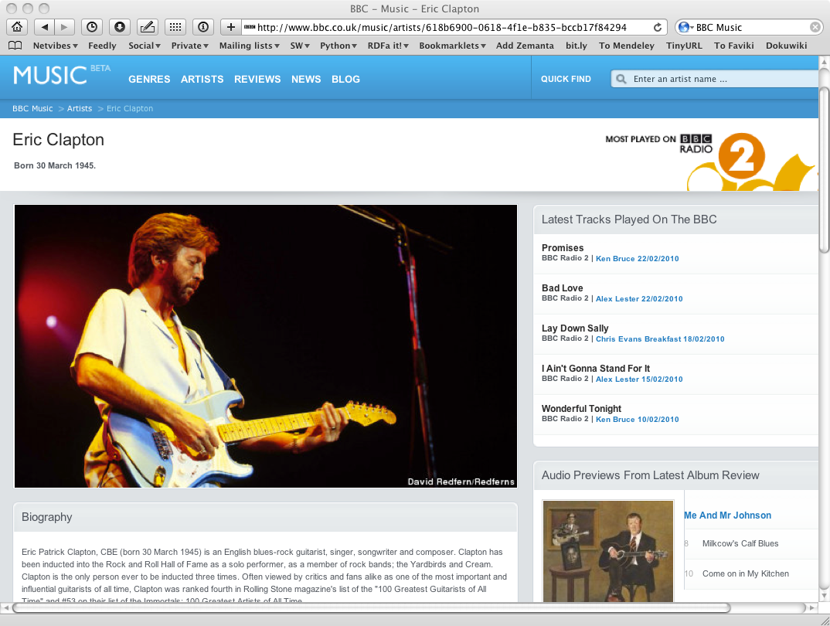
The Music site of the BBC

Slide 3
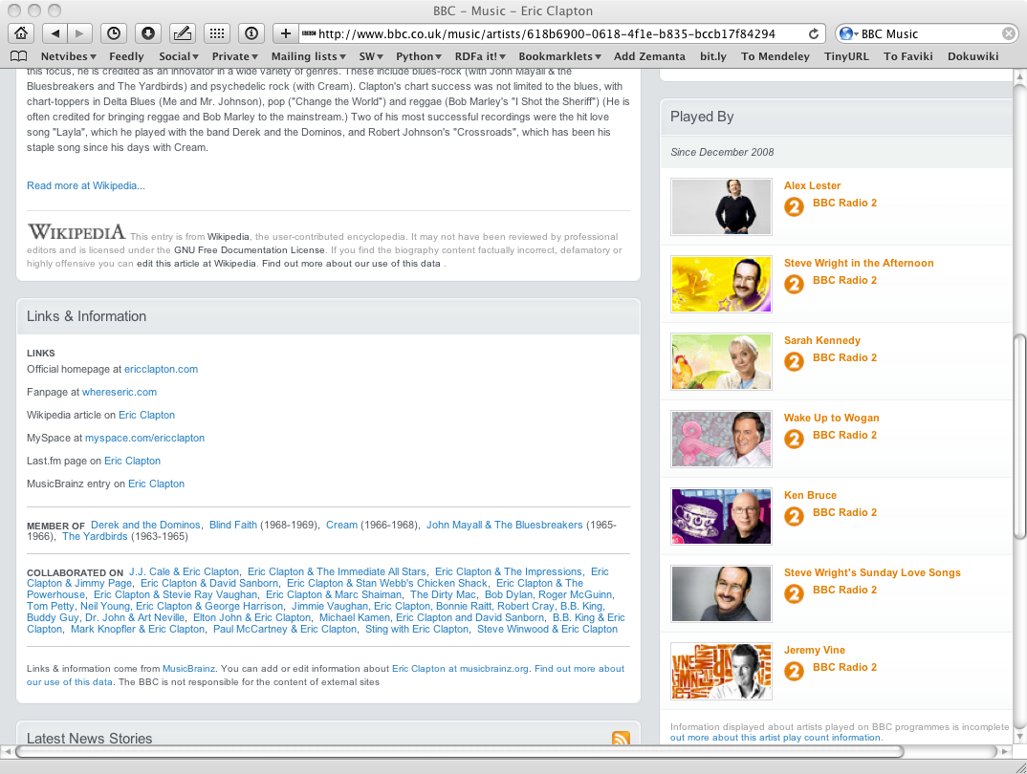
The Music site of the BBC

Slide 4
How to build such a site 1.
Site editors roam the Web for new facts
  may discover further links while roaming
They update the site manually
And the site gets soon out-of-date

Slide 5
How to build such a site 2.
Editors roam the Web for new data published on Web sites
“Scrape” the sites with a program to extract the information
  Ie, write some code to incorporate the new data
Easily get out of date again…

Slide 6
How to build such a site 3.
Editors roam the Web for new data via API-s
Understand those…
  input, output arguments, datatypes used, etc
Write some code to incorporate the new data
Easily get out of date again…

Slide 7
The choice of the BBC
Use external, public datasets
  Wikipedia, MusicBrainz, …
They are available as data
  not API-s or hidden on a Web site
  data can be extracted using, eg, HTTP requests or standard queries

Slide 8
In short…
Use the Web of Data as a Content Management System
Use the community at large as content editors

Slide 9
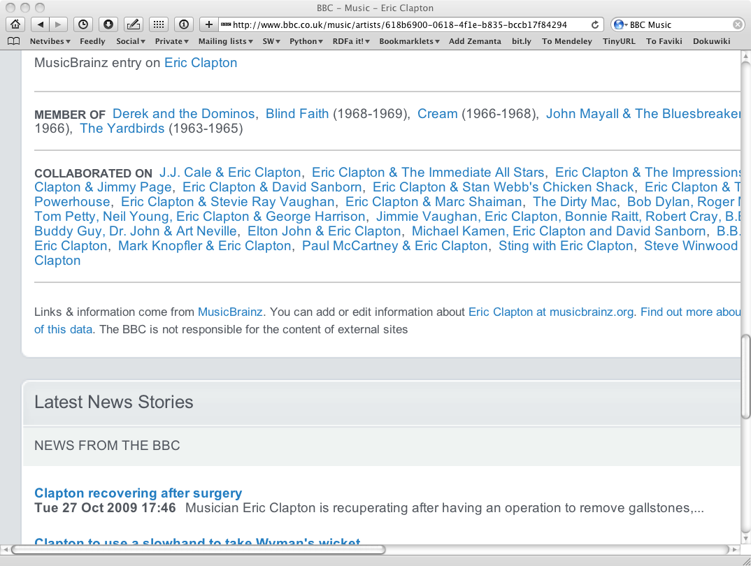
And this is no secret…

Slide 10
Data on the Web
There are more an more data on the Web
  government data, health related data, general knowledge, company information, flight information, restaurants,…
More and more applications rely on the availability of that data

Slide 11
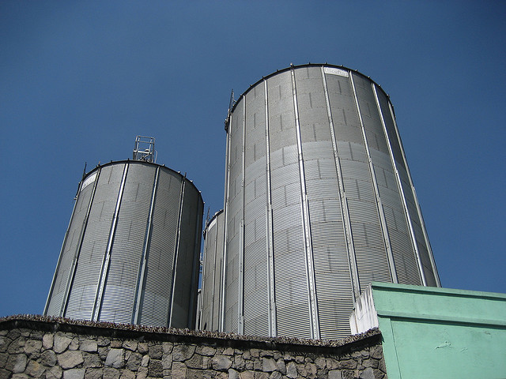
But… data are often in isolation, “silos”
Photo credit “nepatterson”, Flickr

Slide 12
Imagine…
A “Web” where
  documents are available for download on the Internet
  but there would be no hyperlinks among them

Slide 13
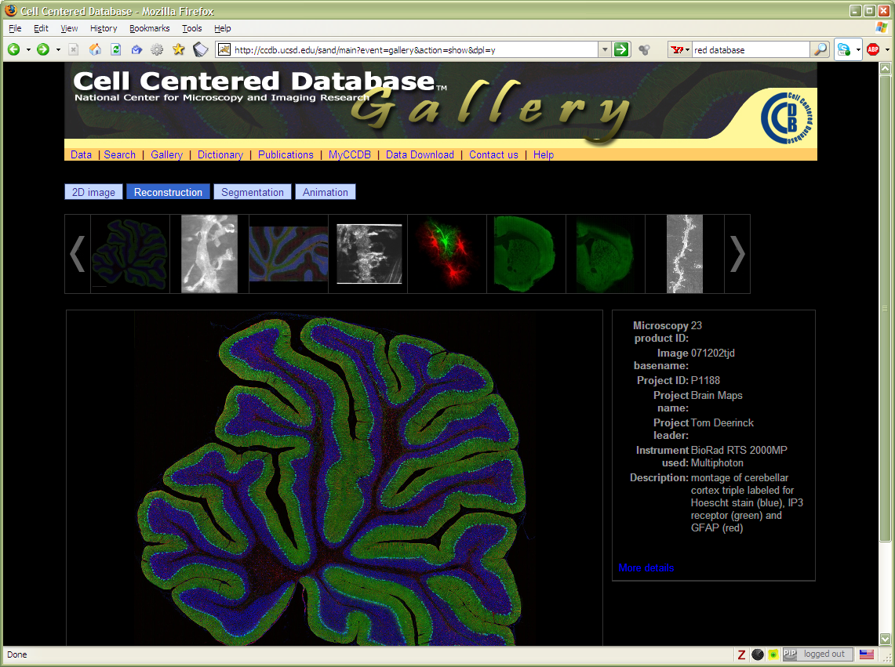
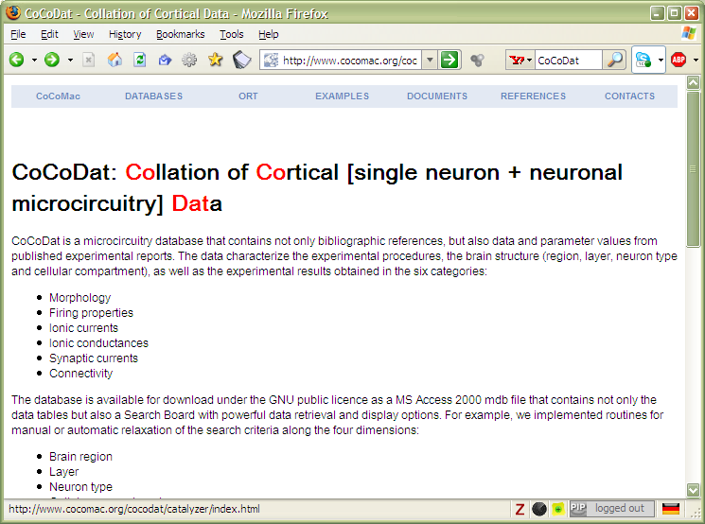
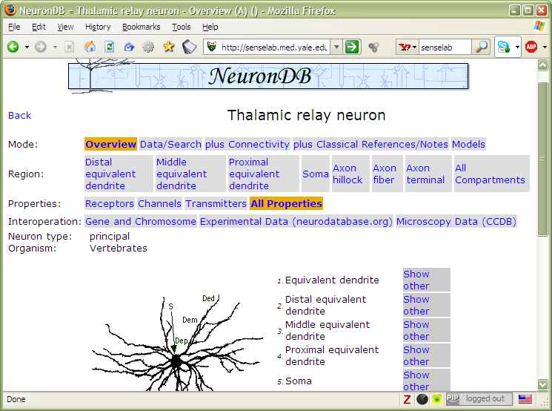
And the problem is real…

Slide 14
Data on the Web is not enough…
We need a proper infrastructure for a real Web of Data
  data is available on the Web
  data are interlinked over the Web (“Linked Data”)
I.e., data can be integrated over the Web

Slide 15
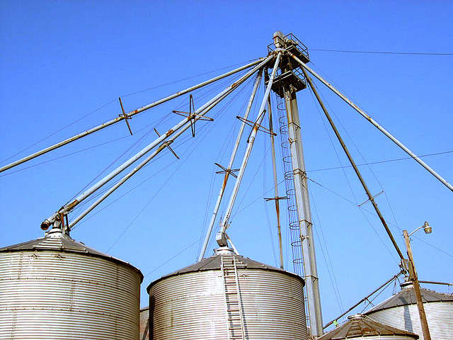
I.e.,… we need to connect the silos
Photo credit “kxlly”, Flickr

Slide 16
In what follows…
We will use a simplistic example to introduce the main Semantic Web concepts

Slide 17
The rough structure of data integration
Map the various data onto an abstract data representation
  make the data independent of its internal representation…
Merge the resulting representations
Start making queries on the whole!
  queries not possible on the individual data sets

Slide 18
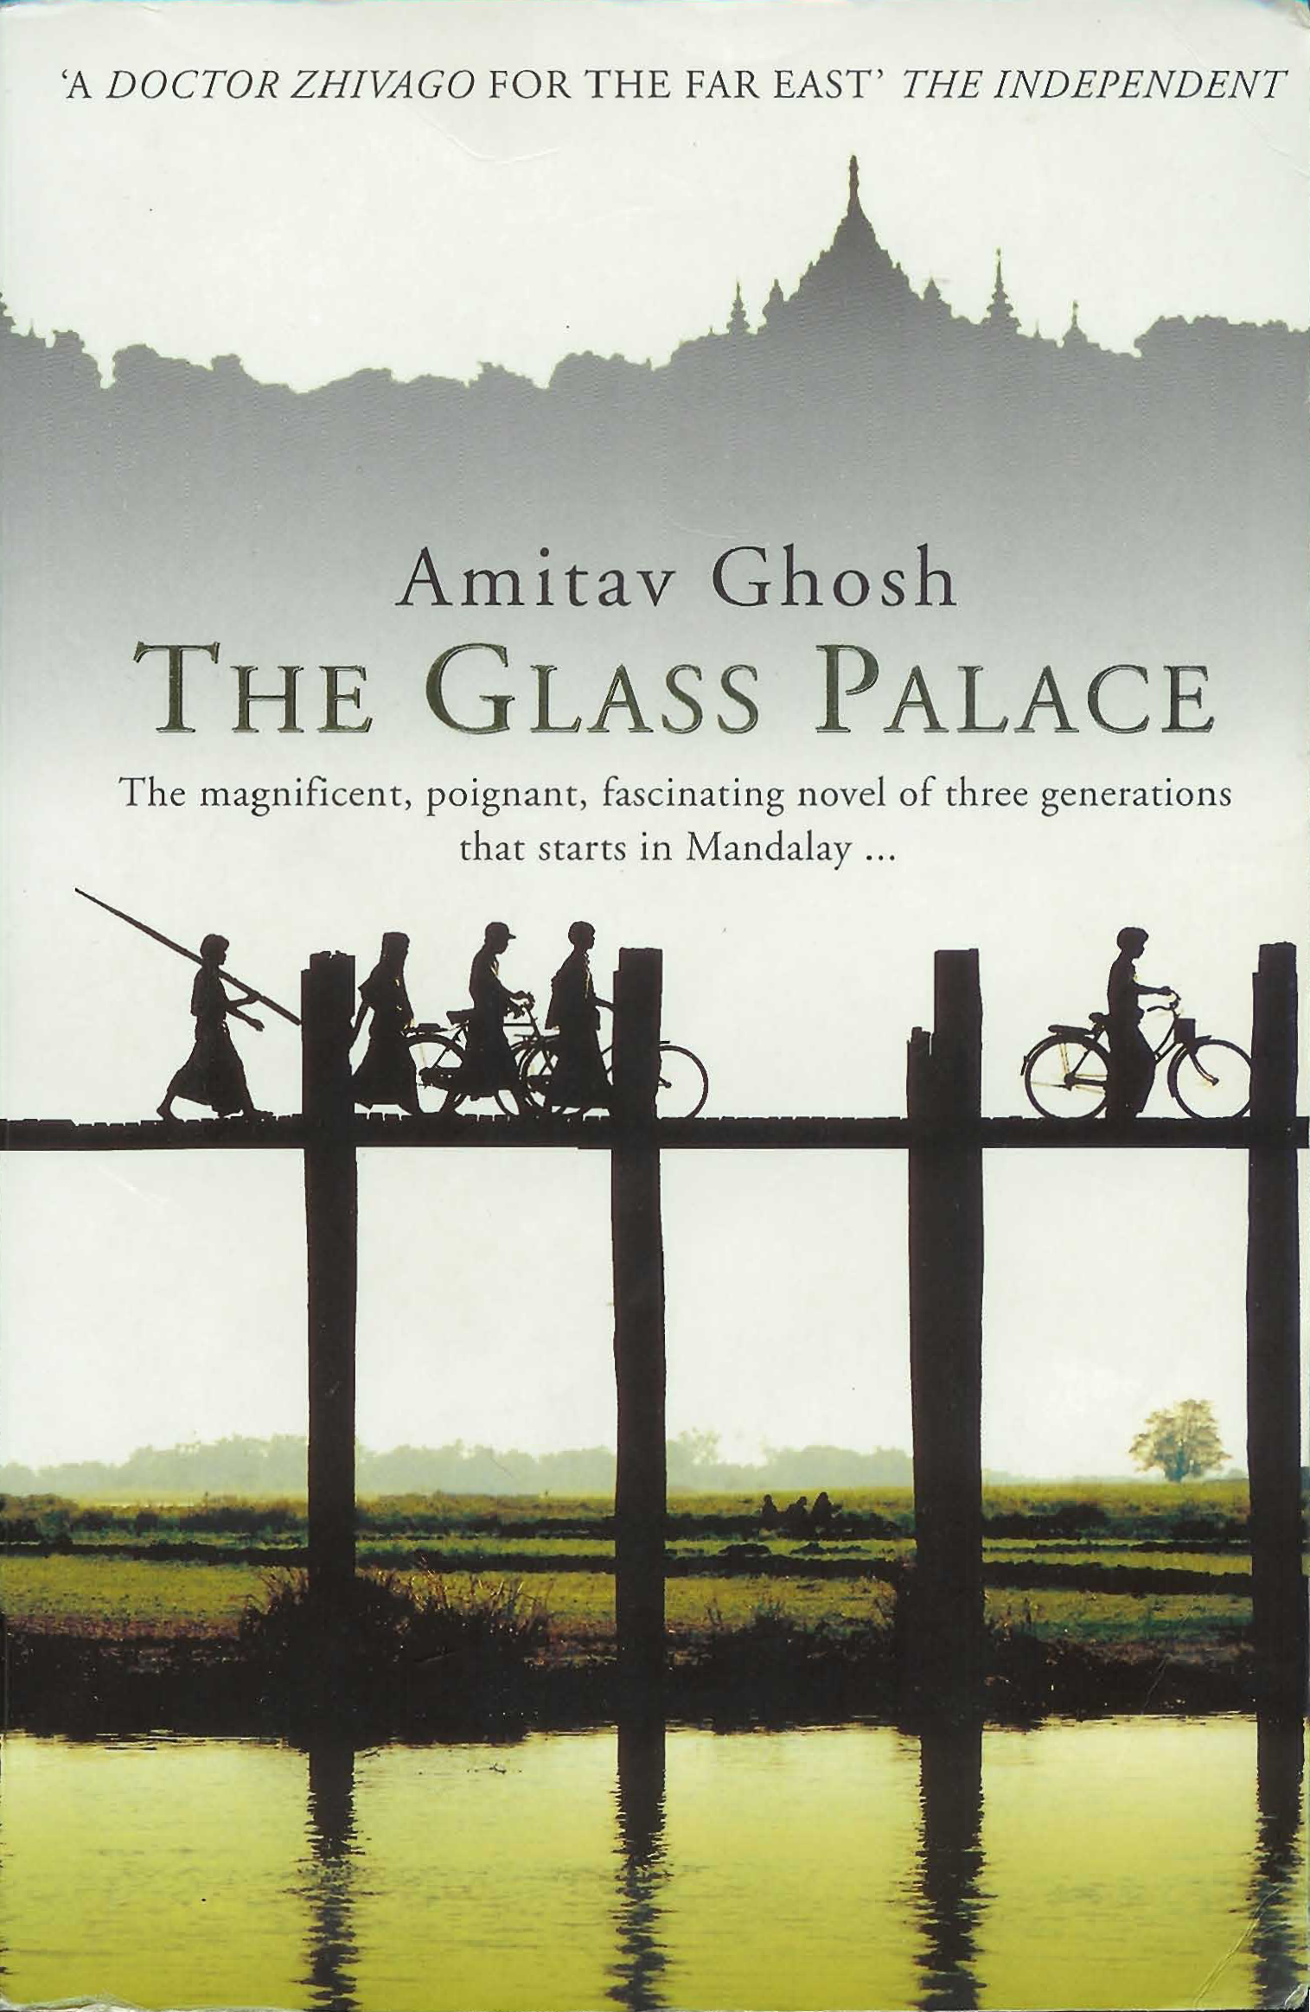
We start with a book...

Slide 19
A simplified bookstore data
(dataset “A”)
ID | Author | Title | Publisher | Year
ISBN 0-00-6511409-X | id_xyz | The Glass Palace | id_qpr | 2000
ID | Name | Homepage
id_xyz | Ghosh, Amitav | http://www.amitavghosh.com
ID | Publisher’s name | City
id_qpr | Harper Collins | London

Slide 20
1st: export your data as a set of relations
a:title
The Glass Palace
http://…isbn/000651409X
2000
a:year
a:publisher
London
a:city
a:author
Harper Collins
a:p_name
a:name
a:homepage
Ghosh, Amitav
http://www.amitavghosh.com

Slide 21
Some notes on the exporting the data
Data export does not necessarily mean physical conversion of the data
  relations can be generated on-the-fly at query time
    via SQL “bridges”
    scraping HTML pages
    extracting data from Excel sheets
    etc.
One can export part of the data

Slide 22

Same book in French…

Slide 23
Another bookstore data
(dataset “F”)
 | A | B | C | D
1 | ID | Titre | Traducteur | Original
2 | ISBN 2020286682 | Le Palais des Miroirs | $A12$ | ISBN 0-00-6511409-X
3
4
5
6 | ID | Auteur
7 | ISBN 0-00-6511409-X | $A11$
8
9
10 | Nom
11 | Ghosh, Amitav
12 | Besse, Christianne

Slide 24
2nd: export your second set of data
http://…isbn/000651409X
Le palais des miroirs
f:original
f:titre
f:auteur
http://…isbn/2020386682
f:traducteur
f:nom
f:nom
Ghosh, Amitav
Besse, Christianne

Slide 25
3rd: start merging your data
The Glass Palace
a:title
http://…isbn/000651409X
2000
a:year
a:city
a:publisher
London
Harper Collins
a:p_name
a:author
a:name
http://…isbn/000651409X
a:homepage
f:original
Le palais des miroirs
Ghosh, Amitav
http://www.amitavghosh.com
f:titre
f:auteur
http://…isbn/2020386682
f:traducteur
f:nom
Ghosh, Amitav
f:nom
Besse, Christianne

Slide 26
3rd: start merging your data (cont)
The Glass Palace
a:title
http://…isbn/000651409X
2000
a:year
a:publisher
Same URI!
London
a:city
Harper Collins
a:p_name
a:author
a:name
http://…isbn/000651409X
a:homepage
f:original
Le palais des miroirs
Ghosh, Amitav
http://www.amitavghosh.com
f:titre
f:auteur
http://…isbn/2020386682
f:traducteur
f:nom
Ghosh, Amitav
f:nom
Besse, Christianne

Slide 27
3rd: start merging your data
The Glass Palace
a:title
http://…isbn/000651409X
2000
a:year
a:city
a:publisher
London
Harper Collins
a:p_name
a:author
f:original
a:name
f:auteur
a:homepage
Le palais des miroirs
Ghosh, Amitav
http://www.amitavghosh.com
f:titre
http://…isbn/2020386682
f:traducteur
f:nom
Ghosh, Amitav
f:nom
Besse, Christianne

Slide 28
Start making queries…
User of data “F” can now ask queries like:
  “give me the title of the original”
    well, … « donnes-moi le titre de l’original »
This information is not in the dataset “F”…
…but can be retrieved by merging with dataset “A”!

Slide 29
However, more can be achieved…
We “feel” that a:author and f:auteur should be the same
But an automatic merge doest not know that!
Let us add some extra information to the merged data:
  a:author same as f:auteur
  both identify a “Person”
  a term that a community may have already defined:
    a “Person” is uniquely identified by his/her name and, say, homepage
    it can be used as a “category” for certain type of resources

Slide 30
3rd revisited: use the extra knowledge
The Glass Palace
a:title
http://…isbn/000651409X
2000
a:year
f:original
Le palais des miroirs
a:publisher
f:titre
London
a:city
Harper Collins
a:p_name
a:author
http://…isbn/2020386682
f:auteur
r:type
f:traducteur
a:name
http://…foaf/Person
r:type
f:nom
a:homepage
f:nom
Besse, Christianne
Ghosh, Amitav
http://www.amitavghosh.com

Slide 31
Start making richer queries!
User of dataset “F” can now query:
  “donnes-moi la page d’accueil de l’auteur de l’original”
    well… “give me the home page of the original’s ‘auteur’”
The information is not in datasets “F” or “A”…
…but was made available by:
  merging datasets “A” and datasets “F”
  adding three simple extra statements as an extra “glue”

Slide 32
Combine with different datasets
Using, e.g., the “Person”, the dataset can be combined with other sources
For example, data in Wikipedia can be extracted using dedicated tools
  e.g., the “dbpedia” project can extract the “infobox” information from Wikipedia already…

Slide 33
Merge with Wikipedia data
The Glass Palace
a:title
http://…isbn/000651409X
2000
a:year
f:original
Le palais des miroirs
a:publisher
f:titre
London
a:city
Harper Collins
a:p_name
a:author
http://…isbn/2020386682
f:auteur
r:type
f:traducteur
a:name
http://…foaf/Person
r:type
f:nom
a:homepage
r:type
f:nom
Besse, Christianne
Ghosh, Amitav
http://www.amitavghosh.com
foaf:name
w:reference
http://dbpedia.org/../Amitav_Ghosh

Slide 34
Merge with Wikipedia data
The Glass Palace
a:title
http://…isbn/000651409X
2000
a:year
f:original
Le palais des miroirs
a:publisher
f:titre
London
a:city
Harper Collins
a:p_name
a:author
http://…isbn/2020386682
f:auteur
r:type
f:traducteur
a:name
http://…foaf/Person
r:type
f:nom
a:homepage
r:type
f:nom
w:isbn
Besse, Christianne
Ghosh, Amitav
http://www.amitavghosh.com
foaf:name
w:reference
http://dbpedia.org/../The_Glass_Palace
w:author_of
http://dbpedia.org/../Amitav_Ghosh
w:author_of
http://dbpedia.org/../The_Hungry_Tide
w:author_of
http://dbpedia.org/../The_Calcutta_Chromosome

Slide 35

Merge with Wikipedia data
The Glass Palace
a:title
http://…isbn/000651409X
2000
a:year
f:original
Le palais des miroirs
a:publisher
f:titre
London
a:city
Harper Collins
a:p_name
a:author
http://…isbn/2020386682
f:auteur
r:type
f:traducteur
a:name
http://…foaf/Person
r:type
f:nom
a:homepage
r:type
f:nom
w:isbn
Besse, Christianne
Ghosh, Amitav
http://www.amitavghosh.com
foaf:name
w:reference
http://dbpedia.org/../The_Glass_Palace
w:author_of
http://dbpedia.org/../Amitav_Ghosh
w:born_in
w:author_of
http://dbpedia.org/../Kolkata
http://dbpedia.org/../The_Hungry_Tide
w:long
w:lat
w:author_of
http://dbpedia.org/../The_Calcutta_Chromosome

Slide 36
Is that surprising?
It may look like it but, in fact, it should not be…
What happened via automatic means is done every day by Web users!
The difference: a bit of extra rigour so that machines could do this, too

Slide 37
What did we do?
We combined different datasets that
  are somewhere on the web
  are of different formats (mysql, excel sheet, etc)
  have different names for relations
We could combine the data because some URI-s were identical (the ISBN-s in this case)

Slide 38
What did we do?
We could add some simple additional information (the “glue”), also using common terminologies that a community has produced
As a result, new relations could be found and retrieved

Slide 39
It could become even more powerful
We could add extra knowledge to the merged datasets
  e.g., a full classification of various types of library data
  geographical information
  etc.
This is where ontologies, extra rules, etc, come in
  ontologies/rule sets can be relatively simple and small, or huge, or anything in between…
Even more powerful queries can be asked as a result

Slide 40
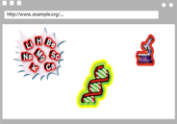
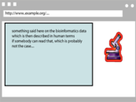


What did we do? (cont)
Applications
Manipulate
Query
…
Map,
Expose,
…
Data represented in abstract format
Data in various formats

Slide 41
So what is the Semantic Web?
The Semantic Web is a collection of technologies to make such integration of Linked Data possible!

Slide 42
Details: many different technologies
an abstract model for the relational graphs: RDF
add/extract RDF information to/from XML, (X)HTML: GRDDL, RDFa
a query language adapted for graphs: SPARQL
characterize the relationships and resources: RDFS, OWL, SKOS, Rules
  applications may choose among the different technologies
reuse of existing “ontologies” that others have produced (FOAF in our case)

Slide 43
Using these technologies…
Applications
SPARQL,
Inferences
…
RDB ⬄ RDF,
GRDDL, RDFa,
…
Data represented in RDF with extra knowledge (RDFS, SKOS, RIF, OWL,…)
Data in various formats

Slide 44
Remember the BBC?

Slide 45
Remember the BBC?

Slide 46
What happens is…
Datasets (e.g., MusicBrainz) are published in RDF
Some simple vocabularies are involved
Those datasets can be queried together via SPARQL
The result can be displayed following the BBC style

Slide 47
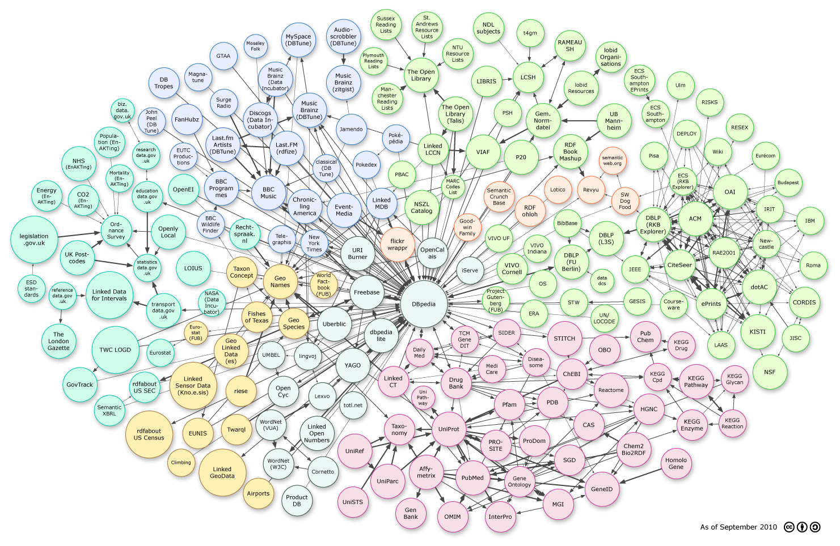
Some examples of datasets available on the Web

Slide 48
What has been achieved so far?
A set of core technologies are in place
Lots of data (billions of relationships) are available in standard format
  see the Linked Open Data Cloud

Slide 49
What has been achieved so far?
There is a vibrant community of
  academics: universities of Southampton, Oxford, Stanford, PUC
  small startups: Garlik, Talis, C&P, TopQuandrant, Cambridge Semantics, OpenLink, …
  major companies: Oracle, IBM, SAP, …
  users of Semantic Web data: Google, Facebook, Yahoo!
  publishers of Semantic Web data: New York Times, US Library of Congress, open governmental data (US, UK, France,…)

Slide 50
And, of course, applications emerge
Companies, institutions begin to use the technology:
  BBC, Vodafone, Siemens, NASA, BestBuy, Tesco, Korean National Archives, Pfizer, Chevron, …
    see http://www.w3.org/2001/sw/UseCases
Truth must be said: we still have a way to go
  deployment may still be experimental, or on some specific places only

Slide 51
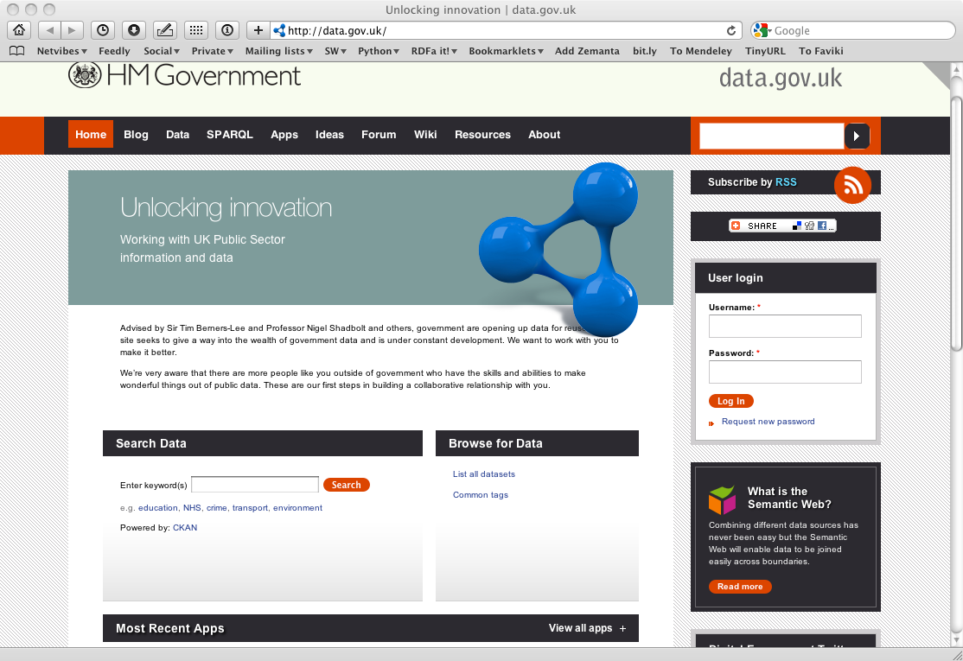
An example for unexpected reuse…

Slide 52
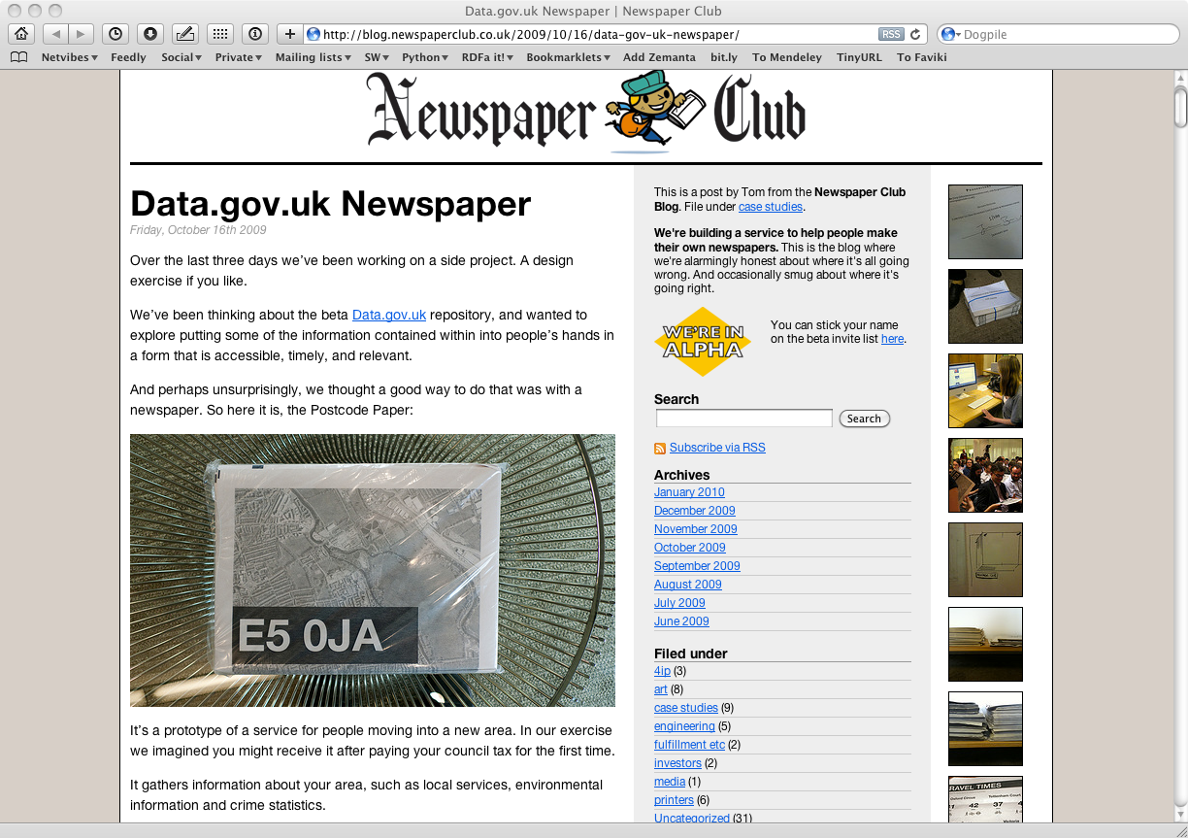
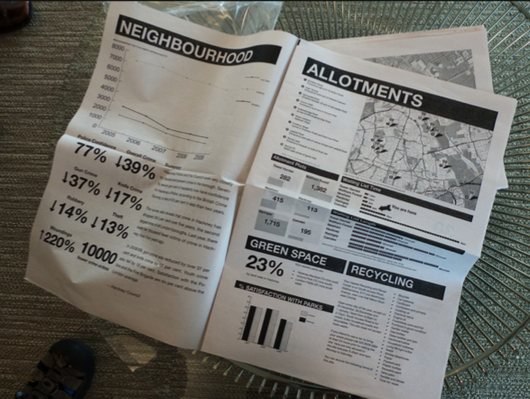
An example for unexpected reuse…
Notes:
The point is: they combine data drawn from data.gov.uk to produce, traditional, printed paper to be distributed in the neighborhood providing practical information like doctors, pharmacies, etc, in an up-to-date fashion

Slide 53
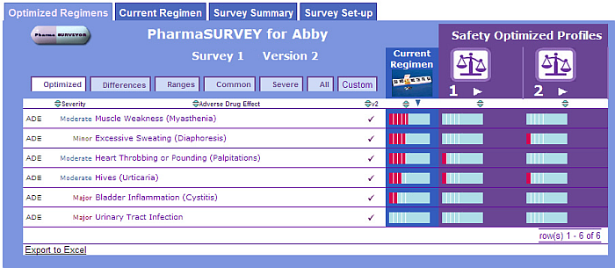
Help in choosing the right drug regimen
Help in finding the best drug regimen for a specific case, per patient
Integrate data from various sources (patients, physicians, Pharma, researchers, ontologies, etc)
Data (eg, regulation, drugs) change often, but the tool is much more resistant against change
Courtesy of Erick Von Schweber, PharmaSURVEYOR Inc., (SWEO Use Case)
Notes:
Tool to find the best drug usage adapted to an individual patient. The navigator tool combines various databases, ontologies to provide a better tool.
The flexibility of the interface is important: the structure of the underlying data (eg, databases, regulation) change often, but by localizing the change on the database-to-RDF mapping, the rest of the system is protected against change; one of the main reasons why this approach was chosen

Slide 54
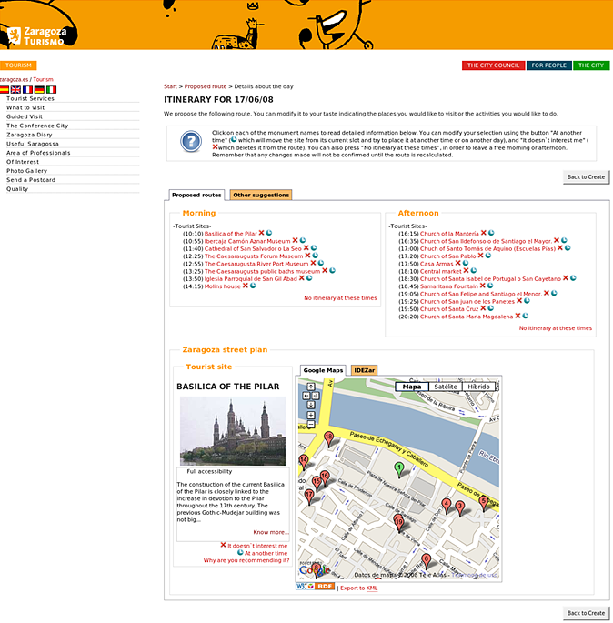
eTourism: provide personalized itinerary
Integration of relevant data in Zaragoza
Use rules to provide a proper itinerary
Courtesy of Jesús Fernández, Mun. of Zaragoza, and Antonio Campos, CTIC (SWEO Use Case)

Slide 55
Everything is not rosy, of course…
Tools have to improve
  scaling for very large datasets
  quality check for data
  etc
There is a lack of knowledgeable experts
  this makes the initial “step” tedious
  leads to a lack of understanding of the technology
But we are getting there!

Slide 56
Why is all this good?
A huge amount of data (“information”) is available on the Web
Sites struggle with the dual task of:
  providing quality data
  providing usable and attractive interfaces to access that data

Slide 57
Why is all this good?
Semantic Web technologies allow a separation of tasks:
  publish quality, interlinked datasets
  “mash-up” datasets for a better user experience
“Raw Data Now!”
Tim Berners-Lee, TED Talk, 2009
http://bit.ly/dg7H7Z

Slide 58
Why is all this good?
The “network effect” is also valid for data
There are unexpected usages of data that authors may not even have thought of
“Curating”, using, exploiting the data requires a different expertise

Slide 59

Thank you for your attention!
These slides are also available on the Web:
http://www.w3.org/2010/Talks/1015-SauPaulo-SemCafe-IH/

